Slide 1


Household Fire Weather and Evacuation Planning
Jamie Albrecht jalbrecht@berkeleyca.gov
Berkeley Fire Department, Office of Emergency Services

Slide 2
In this presentation, you will
Learn
Take action
Talk to your neighbors

Slide 3
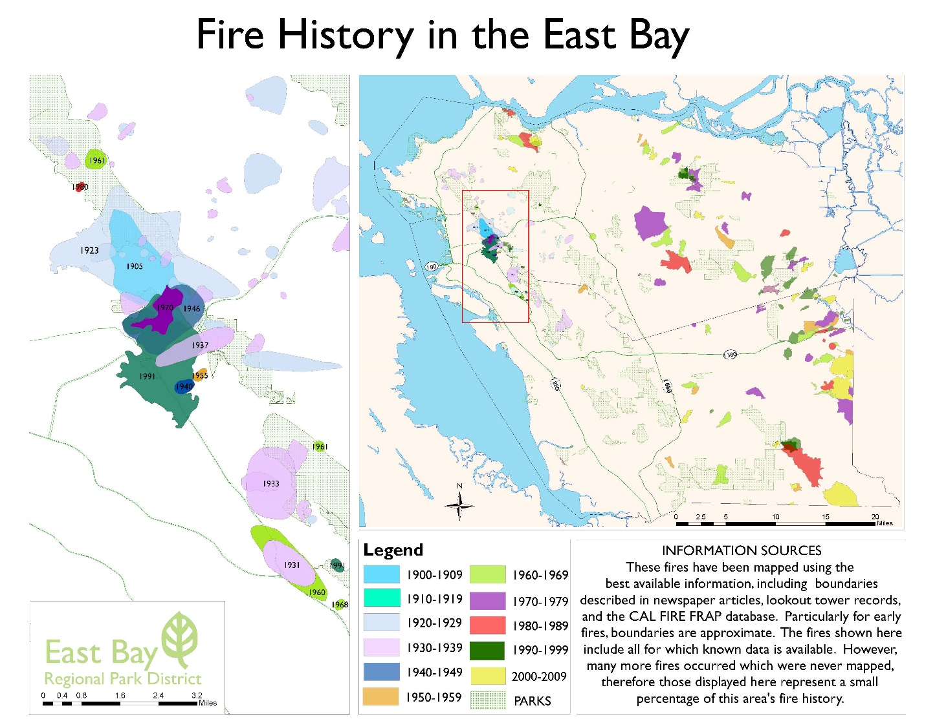
We built where nature needs to burn.

Slide 4
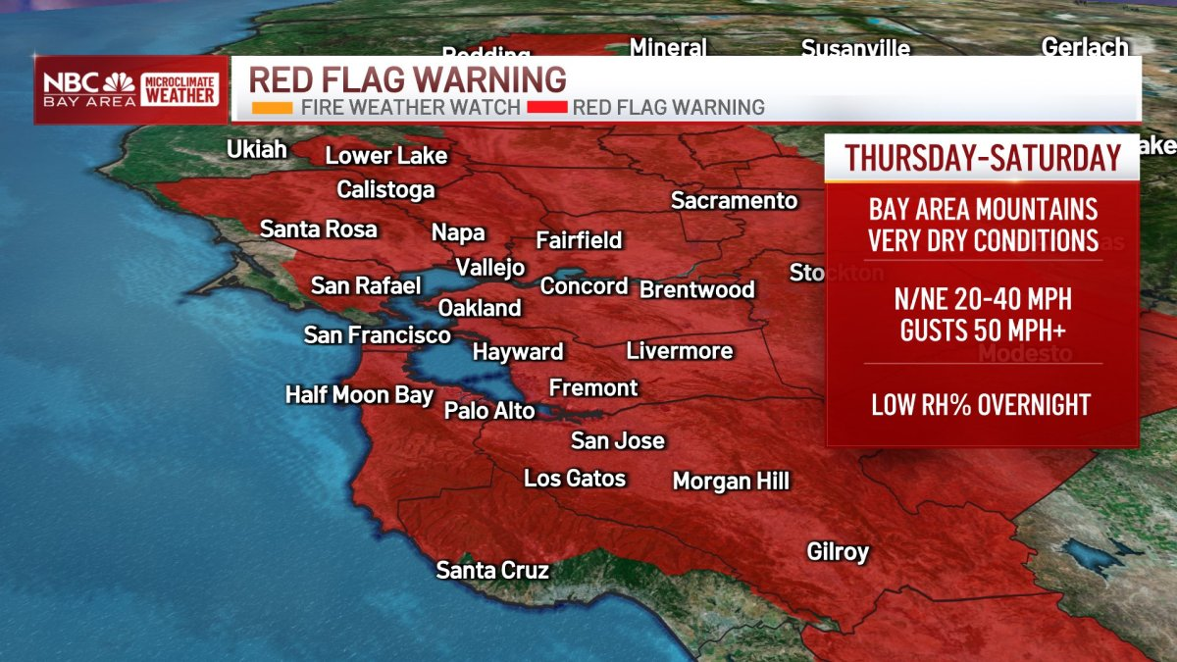
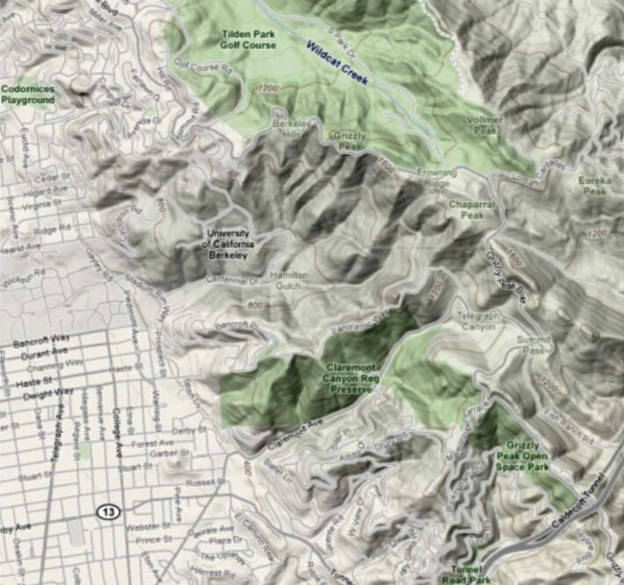
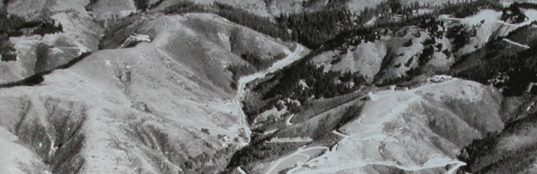
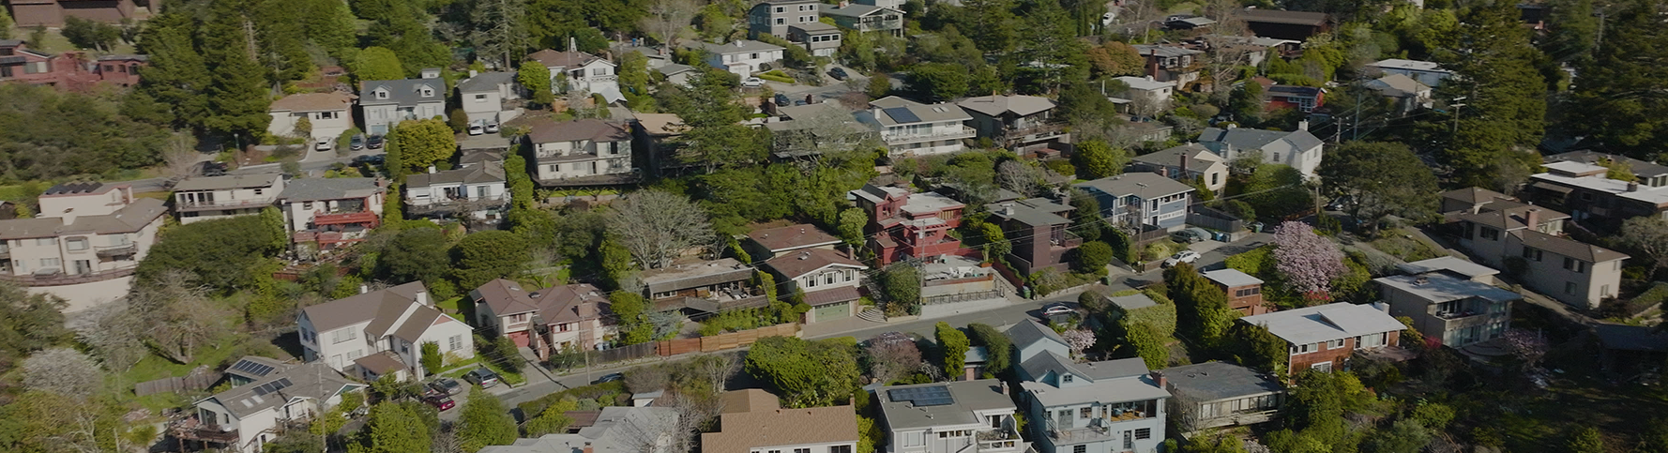
Weather
Topography
THEN
NOW
Fuel
Fuel, weather, and topography are the primary drivers of wildfire behavior
Notes:
[click] Fuel, weather, and topography are the primary drivers of wildfire behavior, shaping its intensity and spread. The East Bay Hills, with elevations reaching 1,700 feet and features like canyons and chutes, channel winds and amplify fire behavior.
[click] Diablo winds, which descend from higher altitudes, become warmer and drier as they compress, accelerating through terrain and creating dangerous, erratic fire conditions.
[click] Historically, the East Bay Hills featured oak-studded grasslands that experienced frequent, fast-moving fires, which naturally burned out due to the limited fuel. Today, urban development has transformed these landscapes into dense forests with fire prone vegetation, increasing the potential for prolonged, intense fires under dry and windy conditions.

Slide 5
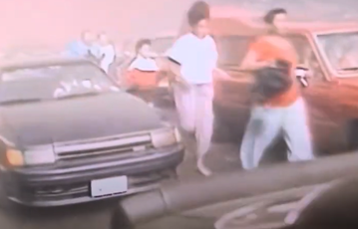
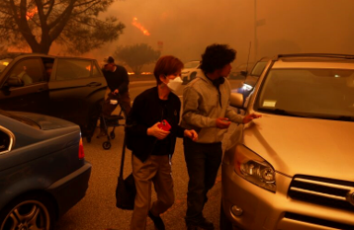
Is this how we want evacuation to go?
Palisades Fire, 2025
Tunnel Fire, 1991
Notes:
We need to get out of they way
We’ve struggled to get out of the way fast enough.
There is an opportunity to do something different.

Slide 6



Evacuation doesn’t start on the road.

Slide 7
Sign up for Emergency Alerts

Slide 8


Emergency Alerting Systems
Sign up for AC Alert (Alameda County)
Sign up for Community Warning System (Contra Costa County)
Find what your local jurisdiction recommends
A reminder to keep your phones on, especially during Red Flag Warnings.

Slide 9


Action
acalert.org
cwsalerts.com

Slide 10
Household Fire Weather Plan
Notes:
Next you need to make a plan so that you can leave as early as possible, cutting down your getting ready time. So you first need to decide when you’re going to leave.
And there are opportunities to leave before a fire even starts, even before you might get a
We just focused on signing up for emergency notifications, but you could decide to leave earlier than your instructed to, even before there is a fire. If there is a fire, your public safety officials are going to

Slide 11
When will you leave?
Evacuation Warning (Prepare to Evacuate)
Evacuation Order (Evacuate Now)
Leave immediately if you feel threatened or see fire near you.
Notes:
BUT THESE ARE NOT your only options

Slide 12
Megafires ignite ​and spread under ​ predictable ​ but rare weather conditions.

Slide 13

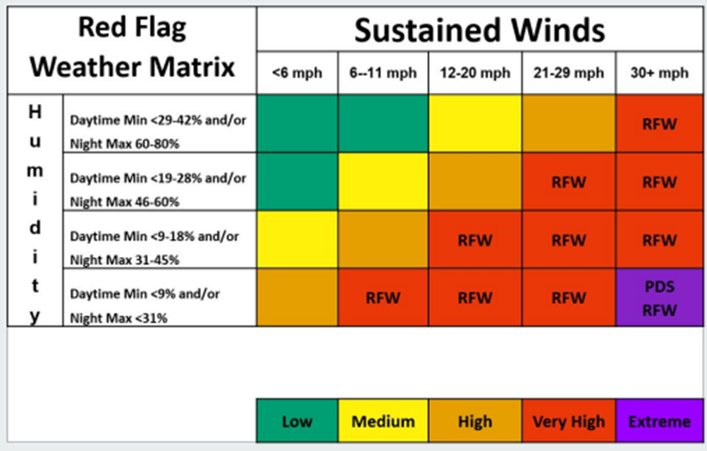
Notes:
Here is what the weather service does for predictions – they tell the community when these conditions are forecasted
This fire this fire, they all happened here.
1991 Oakland Berkeley Fire happened under these conditions
The LA Fires happened under these conditions
Maui Fire happened under tehse conditions
Camp Fire
AND
The National Weather Service tell us when these conditions are forecasted.

Slide 14
When will you leave?
Before a fire starts
Red Flag Warning
Particularly Dangerous Situation
After a fire starts
Evacuation Warning
Evacuation Order

Slide 15









Reasons you might leave before a fire starts
Live in a Fire Hazard Severity Zone
Have children
Need help packing your car
Rely on others for transportation
Have pets
Have a mobility disability
One way in / one way out of neighborhood
Any reason you think you might need or want extra time
Windy, narrow roads
Notes:
Check with your local jurisdiction about the fire hazard severity zone
Have children
Have pets
Have a mobility disability
Your neighborhood has windy, narrow roads
There is one way in and out of your neighborhood
Need someone to help you pack your car
For any reason, you need or want extra time
You need to carpool, or rely on others for transportation

Slide 16


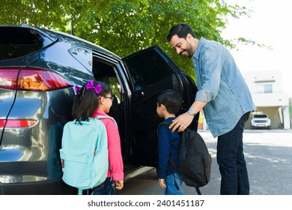



Leave as early as possible
Safety
Notes:
Whether you’re leaving before a fire or after, everyone should leave as early as possible. The earlier you leave, the less chance you will be stuck in traffic trying to get out. More time to get away from the hazard, reduce likelihood you’re traffic.
Some other points that might apply to your family and the plans that you make:
Do not return to the evacuating area
Do not wait for someone to return home to leave, have a place you can meet up. This applies to children in school. In the beginning of school, identify people who can pick your kid up and where you can meet them. The time you spend picking up your child can make your evacuation time to safety slower.
As soon as you receive an evacuation order/warning, leave.
Never wait for someone to return home before evacuating. Make a plan now for where to meet and how to communicate if separated.
If your household is evacuating and you have children in school outside the evacuation zone, ask someone to pick them up and take them to a safe location. This can help your family evacuate faster.

Slide 17
Decide where you will go
Friend or family’s house
Hotel
Other?

Slide 18
Plan how you will get out
Know your neighborhood: the routes and the people.
  Plan at least two ways out of your neighborhood, but be flexible.
  Coordinate with neighbors or people in your immediate vicinity for help.
  Make plans for carpooling.
OES1
Notes:
Recogize that if you leave before a fire, you can do anything you want.
If you leave after a fire starts,

Slide 19
Pack a go bag
Cotton bandana for use while evacuating
Flashlight/headlamp
Wallet
Phone
Water bottle
Medication
Important documents
Sturdy shoes and socks
Extra eyeglasses or contact lenses
Anything else your household needs to stay safe
Notes:
Remember if you leave before a fire starts, you have more time to pack. You can have people come pack important valuables, you can bring a lot more.
This list is focused on things that you need to evacuate but does not focus on valuables or important belongings, because in the event of a fire, you need to be able to carry your belongings and you need to leave as quickly as possible, not packing up anything else.

Slide 20
Talk to each other

Slide 21
Action: 5 Minutes with your neighbor
Introduce yourself
Whereabouts do you live
What’s one thing you’ve already done related to making a household fire weather plan?
What’s one thing you’re still trying to figure out?
Can you help each other out?

Slide 22
Ask for help from your community

Slide 23
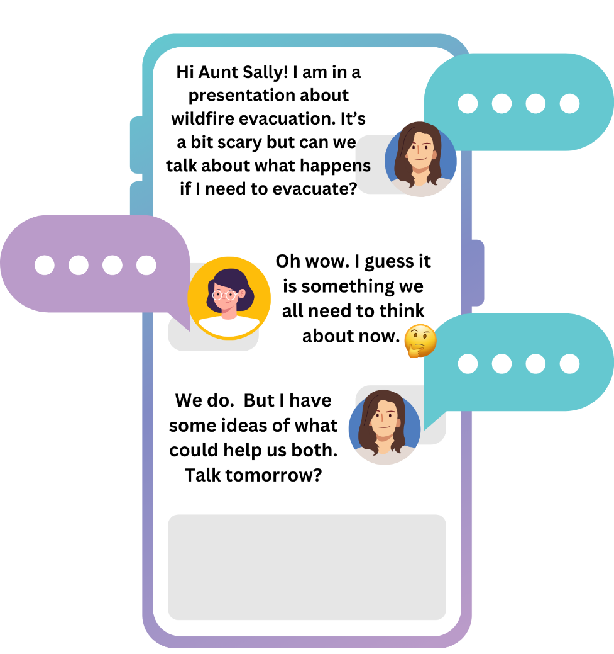
Action: Invite one person to help you
Right now, text, email, or call one person who can help you do one of the following:
  Sign up for notifications
  Decide where to go
  Pack your essentials
OES1

Slide 24
Questions?

Slide 25
Thank you!
Jamie Albrecht oes@berkeleyca.gov
Berkeley Fire Department, Office of Emergency Services

